Slide 1

DOG SHELTER
By team ARTEMISSION

Slide 2
CONTENT
OUR PROGRESS
IDEA OF THE PROJECT
3
OUR TEAM
2
USED
TECHNOGIES
1
4

Slide 3
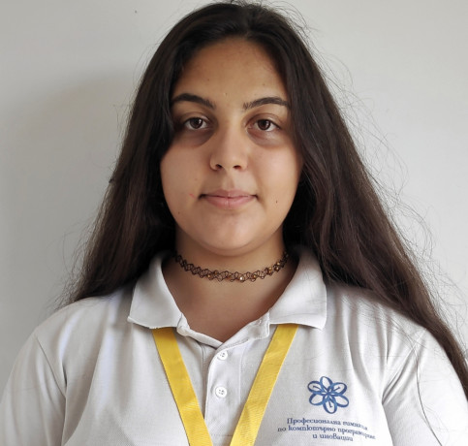
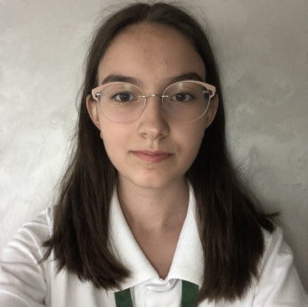
OUR TEAM
Emily Kehayova
Afra Yusrefova
Class 10 A
Class 10 V

Slide 4
IDEA OF THE PROJECT
To create a system that will make adopting animals from shelters easier

Slide 5

OUR PROGRESS
CREATING THE TEAM
DEVELOPING THE PROJECT
PRESENTING THE PROJECT
DAY 1
DAY 4 -7
DAY 10
DAY 8 - 9
DAY 2 - 3
STRUCTURE THE IDEA OF THE PROJECT
FINISHING TOUCHES AND DOCUMENTATION

Slide 6



USED TECHNOLOGIES
Visual studio
MSSQL
Photoshop

Slide 7



